Slide 1

Spell
Me
Codezillas
University of Moratuwa

Slide 2
SPELLING
VOCABULARY
PRONUNCIATION
GRAMMAR

Slide 3


How Important ???
Good spellers are usually good readers and good speakers

Slide 4


GCE Ordinary Level
Fail Percentage
Sinhala
Tamil
English
 | Sinhala | Tamil | English
2015 | 10.77 % | 18.96 % | 54.60 %
2016 | 12.97 % | 21.40 % | 52.10 %
2017 | 9.37 % | 11.28 % | 48.88 %
Source : http://125.214.169.219/exam/downloads.jsf

Slide 5
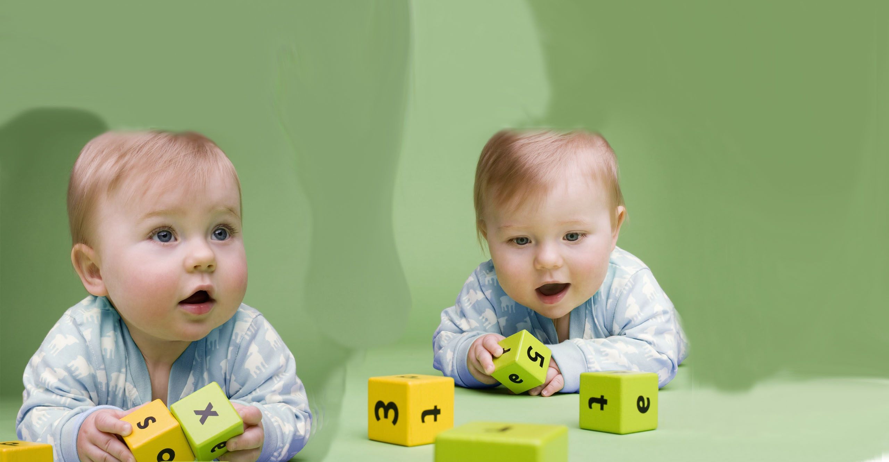
How to Remember ??
Audio
Written
Mnemonics
Visuals
Flash Cards
Recitation

Slide 6
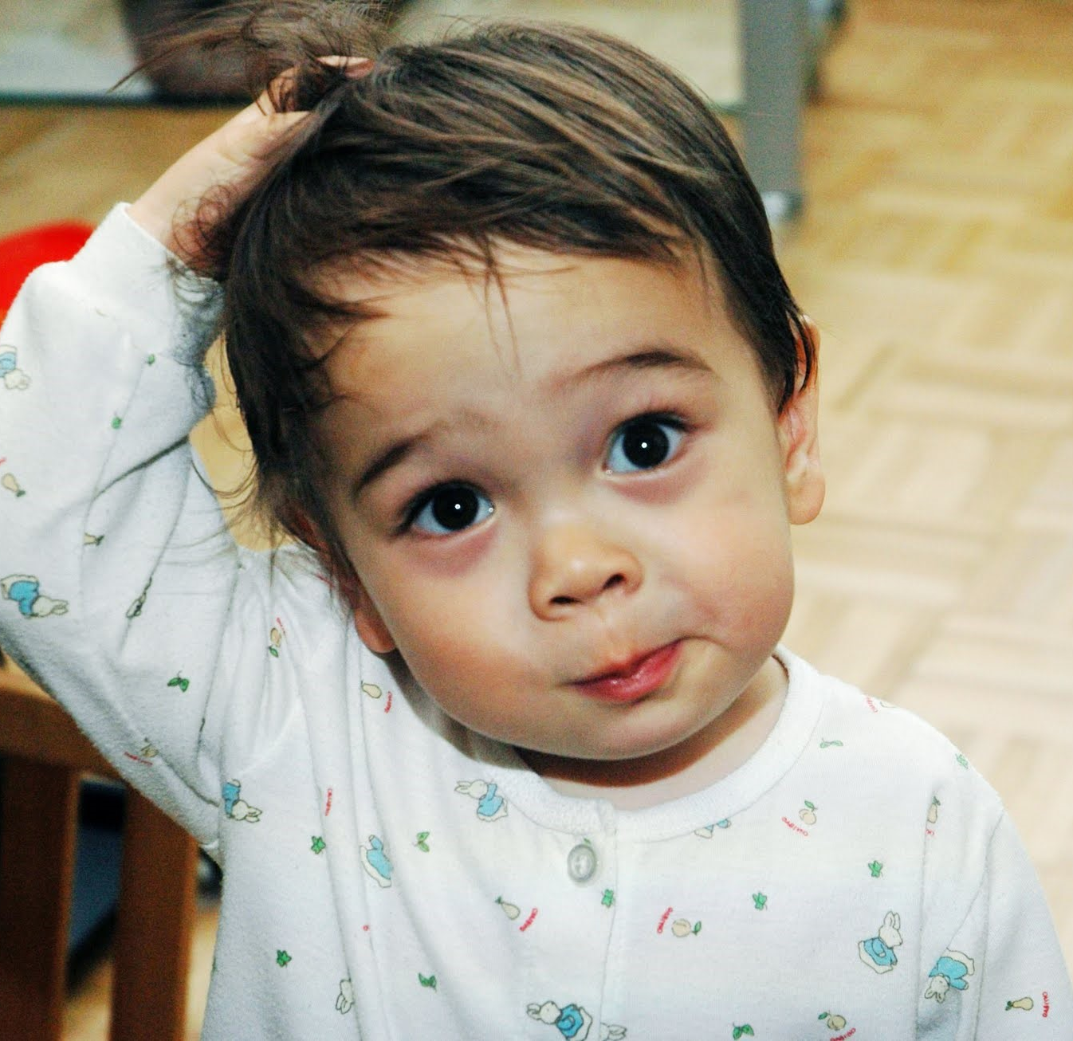
ම
ம
ව
b
வ
ට
d
ப
CONFUSING ????
p

Slide 7
Our Progress
LETTERS
WORDS
SENTENCE
GRAMMAR
BREVITY
CLARITY

Slide 8
Our Future Plans ….
2019
Include natural language processing
Include simple activities from the local Text book
Extend the idea to a foreign language
2018 END
2020

Slide 9
Business Model
Customer Relationship
1.Social Media
2. Customer feedback
Customers
1.Students/kids
2.Learners
Channel
1.Ministry of Education
2.Parents
3.Students
Cost structure
1.Salary to customer support
Travel
Value proposition
1.Free
2. User friendly
Key partners

Slide 10

Thank You

